Slide 1
Introduction
Paragraphs 구성
Photonic Integrated Circuits (PICs) based on Silicon-on-Insulator (SOI)에 대한 관심 증폭[1]
Integrated component에서 power splitter는 필수
“beyond 5G” generation에서 THz optical device의 중요성[2, 3]
THz optical device example: Subwavelength Graphene waveguide (30 THz)[4], Multi-output splitter without grating structure, Genetic Algorithm[5]
기존에는 analytically designed structure를 바탕으로 몇가지 parameters를 조절하는 방법으로 설계
Example: Direct Binary Search [6], self-imaging[7, 8, 9], sweep parameter based on specific structure[10]
제한된 설계 조건, Performance 한계
In this study,
Photonic Integrated Circuits review paper - L. Thylén and L. Wosinski, “Integrated photonics in the 21st century,” Photonics Research, vol. 2, no. 2, p. 75, Jan. 2014.
THz communication, 504 citation - I. F. Akyildiz, J. M. Jornet, and C. Han, “Terahertz band: Next frontier for wireless communications,” Physical Communication, vol. 12, pp. 16–32, 2014.
THz communication recent paper, arxiv 2019 - E. Calvanese Strinati et al., "6G: The Next Frontier: From Holographic Messaging to Artificial Intelligence Using Subterahertz and Visible Light Communication," in IEEE Vehicular Technology Magazine, vol. 14, no. 3, pp. 42-50, Sept. 2019
Subwavelength Graphene waveguide (30 THz) - Z. Guo, X. Nie, F. Shen, H. Zhou, Q. Zhou, J. Gao, and K. Guo, “Actively Tunable Terahertz Switches Based on Subwavelength Graphene Waveguide,” Nanomaterials, vol. 8, no. 9, p. 665, 2018.
Multi-output splitter without grating structure, Genetic Algorithm - F. Zhang, K. Song, and Y. Fan, “New 2D diffraction model and its applications to terahertz parallel-plate waveguide power splitters,” Scientific Reports, vol. 7, no. 1, Sep. 2017.
Direct Binary Search algorithm - L. Lu, M. Zhang, F. Zhou, and D. Liu, “An Ultra-compact Colorless 50:50 Coupler Based on PhC-like Metamaterial Structure,” Optical Fiber Communication Conference, 2016.
Self-imaging, NxN multimode - M. Bachmann, P. A. Besse, and H. Melchior, “General self-imaging properties in N × N multimode interference couplers including phase relations,” Applied Optics, vol. 33, no. 18, p. 3905, 1994.
Self-imaging, multimode, review - L. Soldano and E. Pennings, “Optical multi-mode interference devices based on self-imaging: principles and applications,” Journal of Lightwave Technology, vol. 13, no. 4, pp. 615–627, 1995.
Analytic method - Eigenmode decomposition theory - Y. Tian, J. Qiu, M. Yu, Z. Huang, Y. Qiao, Z. Dong, and J. Wu, “Broadband 1 × 3 Couplers With Variable Splitting Ratio Using Cascaded Step-Size MMI,” IEEE Photonics Journal, vol. 10, no. 3, pp. 1–8, 2018.
Butterfly geometry - P. Besse, E. Gini, M. Bachmann, and H. Melchior, “New 2×2 and 1×3 multimode interference couplers with free selection of power splitting ratios,” Journal of Lightwave Technology, vol. 14, no. 10, pp. 2286–2293, 1996.

Slide 2
Introduction – Machine Learning & Deep Learning
Paragraphs 구성
Machine learning[11]과 deep learning[12]은 여러분야에서 문제해결을 위한 강력한 도구로서 사용되고 있다.
Biology[13, 14], environmental[15], health science[16]
Photonics 분야에서도 machine learning를 활용하여 기존의 방식보다 효율적으로 photonic device를 설계할 수 있다.
Machine learning example: Alternating Directions Method of Multipliers (ADMM) optimization[17, 18]
Deep learning example: Artificial Neural Networks [19, 20]
본 논문에서는 machine learning 알고리즘 Additive Reinforcement Learning(ARL)과 deep learning 알고리즘 Aritifical Neural Network(ANN)을 사용하여 1D DBR과 1x2 power splitter를 설계할 것이다.
Mitchell, Tom M. Machine Learning. McGraw Hill, 1997.
Lecun, Yann, et al. “Deep Learning.” Nature, vol. 521, no. 7553, 28 May 2015, pp. 436–444., doi:10.1038/nature14539.
M. Steinegger and J. Söding, “Clustering huge protein sequence sets in linear time,” Nature Communications, vol. 9, no. 1, 2018.Machine Learning_Alternating Directions Method of Multipliers (ADMM) optimization algorithm - A. Y. Piggott, J. Lu, K. G. Lagoudakis, J. Petykiewicz, T. M. Babinec, and J. Vučković, “Inverse design and demonstration of a compact and broadband on-chip wavelength demultiplexer,” Nature Photonics, vol. 9, no. 6, pp. 374–377, 2015.
C. W. Wang, “New Ensemble Machine Learning Method for Classification and Prediction on Gene Expression Data,” Encyclopedia of Healthcare Information Systems, pp. 982–989, 2008.
J.-F. Exbrayat, Y. Y. Liu, and M. Williams, “Impact of deforestation and climate on the Amazon Basin’s above-ground biomass during 1993–2012,” Scientific Reports, vol. 7, no. 1, 2017.
R. Miotto, F. Wang, S. Wang, X. Jiang, and J. T. Dudley, “Deep learning for healthcare: review, opportunities and challenges,” Briefings in Bioinformatics, vol. 19, no. 6, pp. 1236–1246, Jun. 2017.
Machine Learning_Alternating Directions Method of Multipliers (ADMM) optimization algorithm, T-shape Polarizatino Beamsplitter - Z. Ye, J. Qiu, C. Meng, L. Zheng, Z. Dong, and J. Wu, “Inverse Design of a SOI T-junction Polarization Beamsplitter,” Journal of Physics: Conference Series, vol. 844, p. 012009, 2017.
Machine Learning_Alternating Directions Method of Multipliers (ADMM) optimization algorithm - A. Y. Piggott, J. Petykiewicz, L. Su, and J. Vučković, “Fabrication-constrained nanophotonic inverse design,” Scientific Reports, vol. 7, no. 1, Nov. 2017.
Deep Learning_ResNet algorithm (without Convolutional Networks) - M. H. Tahersima, K. Kojima, T. Koike-Akino, D. Jha, B. Wang, C. Lin, and K. Parsons, “Deep Neural Network Inverse Design of Integrated Photonic Power Splitters,” Scientific Reports, vol. 9, no. 1, 2019.
Deep Learning_Covolutional Neural Network(CNN) algorithm - M. H. Tahersima, K. Kojima, T. Koike-Akino, D. Jha, B. Wang, C. Lin, and K. Parsons, “Nanostructured Photonic Power Splitter Design via Convolutional Neural Networks,” Conference on Lasers and Electro-Optics, 2019.

Slide 3
Introduction – Machine Learning & Deep Learning
Artificial Intelligence
Machine Learning
Deep Learning
Machine Learning:
A computer program is said to learn from experience E with respect to some class of tasks T and performance measure P if its performance at tasks in T , as measured by P, improves with experience E.
Deep Learning:
Deep learning is a particular kind of machine learning that achieves great power and flexibility by learning to represent the world as nested hierarchy of concepts, with each concept defined in relation to simpler concepts, and more abstract representations computed in terms of less abstract ones

Slide 4
Method
Additive Reinforcement Learning (ARL)
Perceptron-like machine learning algorithm[21]
“The algorithm combines the additive updates feature of the perceptron algorithm and the reward for state idea of reinforcement learning”[22]
Structure can be express by binary matrix( ex. “1” for etched (air), “0” for not etched (Si))
Define reward(ex. min(T1) + min(T2) - |R|), and maximize it.
The algorithm consist of two phases: training and inference.
Training Phase: Generate training data and accumulate the rewards in a summation matrix
Inference Phase: normalizing and applying activation function to the summation matrix
Figure: Algorithm flowchart
C. Latifoglu, “Binary matrix guessing problem,” Jan. 2017. [Online]. Available: arXiv: e-prints, vol.1701.06167
M. Turduev, E. Bor, C. Latifoglu, I. H. Giden, Y. S. Hanay, and H. Kurt, “Ultracompact Photonic Structure Design for Strong Light Confinement and Coupling Into Nanowaveguide,” Journal of Lightwave Technology, vol. 36, no. 14, pp. 2812–2819, 2018.

Slide 5
Figure: Algorithm flowchart
Generate Training Data
Training Phase
Reward Calculation and
Data Storage
Inference Phase
Analyzing Stored Data
Final Photonic Structure

Slide 6

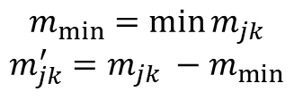
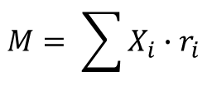

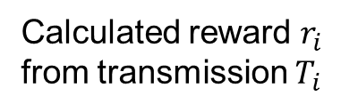
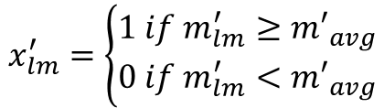

Training Phase
Binary matrix
1 for etched (air)
0 for not etched (Si)
Calculated reward $r_{i}$
from transmission $T_{i}$
$$X_{i}= \left(\begin{aligned}1 1 0 0 ⋯11 \\ 1 1 0 0 ⋯11 \\ ⋮ ⋱ ⋮ \\ 1 1 1 1 ⋯1 1\end{aligned}\right)$$
$$X_{i}, r_{i}$$
Inference Phase
Accumulate the reward in a summation matrix M
$$M= \sum{X_{i}∙r_{i}}$$
Normalizing summation matrix M’
$$m_{min}=\min{m_{jk}}$$
$$m_{jk}^{′}=m_{jk} −m_{min}$$
Activation function
$$x_{lm}^{′}$$
$${m′}_{avg}=\frac{\sum{{m′}_{jk}}}{N′}$$
1
$$x_{lm}^{′}=\left\{\begin{aligned}1 if m_{lm}^{′}≥{m′}_{avg} \\ 0 if m_{lm}^{′}<{m′}_{avg}\end{aligned}\right.$$
0
$${m′}_{avg}$$
$$m_{jk}$$

Slide 7
Method
Inverse Design with Artificial Neural Network (ANN)
Inverse Design은 photonic devices 설계에서 매우 주목받고 있는 방법이다. [23]
Inverse design problems can be classified into two main categories[24]: the genetic algorithm[25, 25] and adjoint method[27, 28].
Genetic algorithm need a lot of computation power and time.
Adjoint method efficient, but need a deep knowledge.
“The ‘approximated’ gradient of the reward with respect to input parameters is then obtained analytically with standard back propagation.”
“The parameters are then optimized efficiently with the gradient descent method.”
Tensorflow를 사용하여 ANN 구현[29]
Figure: Inverse Design
S. Molesky, Z. Lin, A. Y. Piggott, W. Jin, J. Vucković, and A. W. Rodriguez, “Inverse design in nanophotonics,” Nature Photonics, vol. 12, no. 11, pp. 659–670, 2018.
J. Peurifoy, Y. Shen, L. Jing, Y. Yang, F. Cano-Renteria, B. G. Delacy, J. D. Joannopoulos, M. Tegmark, and M. Soljačić, “Nanophotonic particle simulation and inverse design using artificial neural networks,” Science Advances, vol. 4, no. 6, 2018.
M. Mitchell, An introduction to genetic algorithms. Cambridge, MA: MIT, 1998.
Z. Yu, H. Cui, and X. Sun, “Genetically optimized on-chip wideband ultracompact reflectors and Fabry–Perot cavities,” Photonics Research, vol. 5, no. 6, May 2017.
M. B. Giles and N. A. Pierce, “An introduction to the adjoint approach to design,” Flow, Turbulense and Combustion, vol. 65, pp. 393–425, 2001.
A. Y. Piggott, J. Lu, T. M. Babinec, K. G. Lagoudakis, J. Petykiewicz, and J. Vučković, “Inverse design and implementation of a wavelength demultiplexing grating coupler,” Scientific Reports, vol. 4, no. 1, 2014.
arXiv:1605.08695 [cs.DC]

Slide 8
T
Forward Design
T
Inverse Design

Slide 9
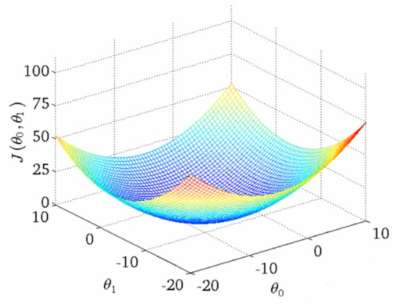
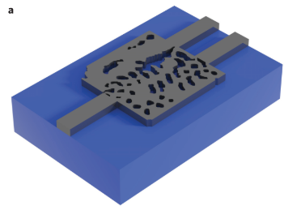







Inverse Design Process
FDTD
spectrum
$X_{i}$
$$f\left(x\right)$$
$$T_{i}$$
$$r_{i}$$
Cost
function
structure
$$\frac{1}{r_{i}}, Const.−r_{i}$$
minimize
Minimize by
gradient descent algorithm
Gradient
$$Cost$$
$x_{i, jk}$
A. Y. Piggott et al., Nature Photonics, vol. 9, no. 6, pp. 374–377, Nov. 2015.

Slide 10
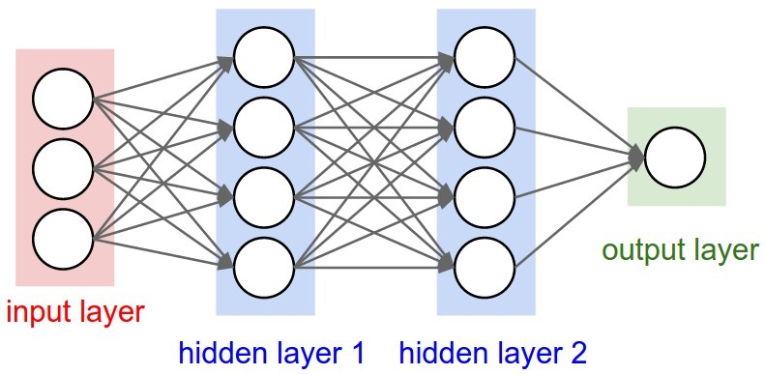




Inverse Design Process
Learning
Neural
Network
$X_{i}$
$$f\left(x\right)$$
$$T_{i}$$
$$r_{i}$$

Slide 11
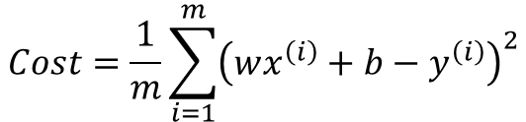


Inverse Design Process
bias
b
Training Data
x | y
1 | 2
2 | 3
3 | 4
x
1
2
3
Activation
function
y
2
3
4
weight
:
x
w
wx+b
y
$$Cost=\frac{1}{m}\sum_{i=1}^{m}{{\left(wx^{\left(i\right)}+b−y^{\left(i\right)}\right)}^{2}}$$
Gradient
$$Cost$$
$$W$$
$$b$$

Slide 12
Inverse Design Process
bias
b
Training Data
x | y
1 | 2
2 | 3
3 | 4
x
1
2
3
Activation
function
y
2
3
4
weight
:
x
w
wx+b
y
b = 1
w = 1
bias
1
x
4
Activation
function
y
5
weight
x
1
wx+b
y

Slide 13
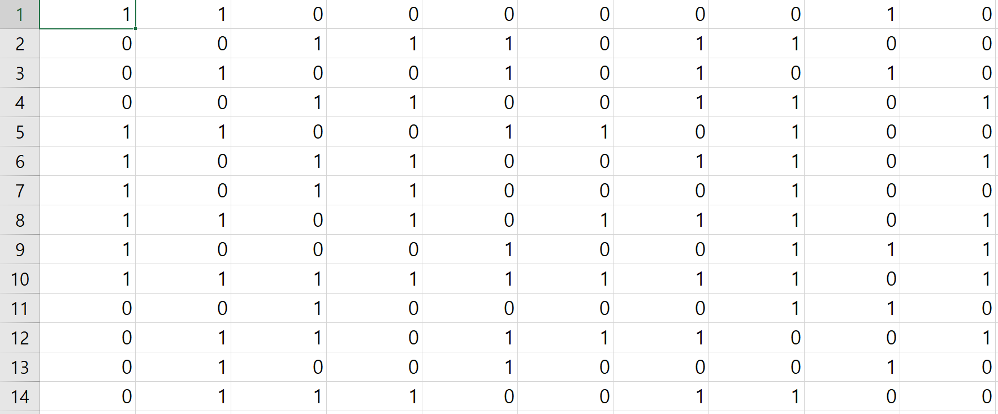
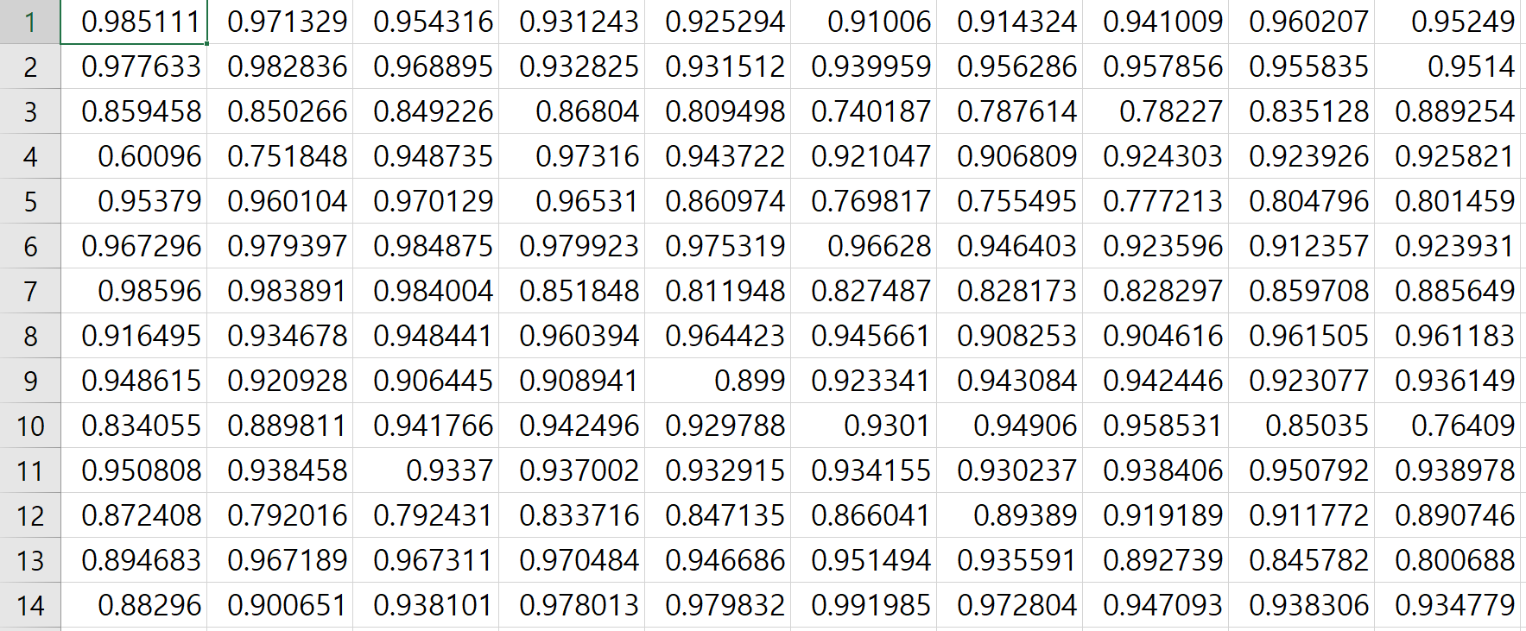




Inverse Design Process
Artificial Neural Network
(ANN)
structures
spectrum
Neural
Network
$X_{i}$
$$f\left(x\right)$$
$$T_{i}$$
$$r_{i}$$

Slide 14
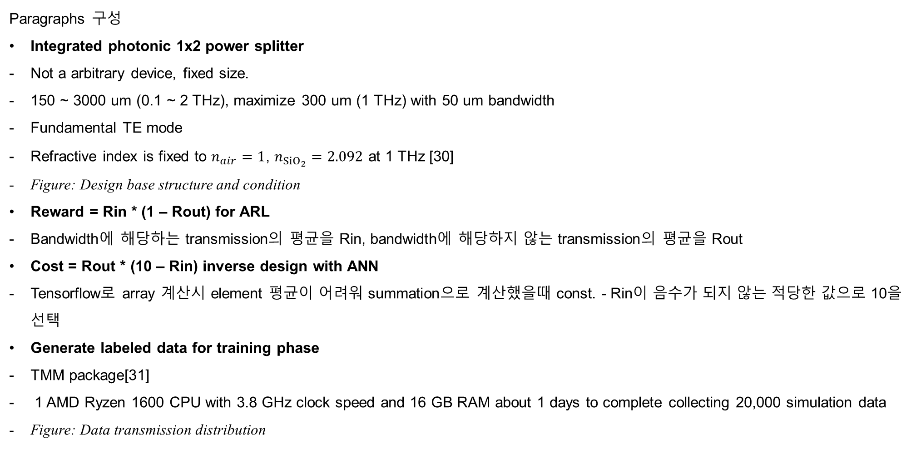
Method – 1D DBR
Paragraphs 구성
Integrated photonic 1x2 power splitter
Not a arbitrary device, fixed size.
150 ~ 3000 um (0.1 ~ 2 THz), maximize 300 um (1 THz) with 50 um bandwidth
Fundamental TE mode
Refractive index is fixed to $n_{air}=1$, $n_{SiO_{2}}=2.092$ at 1 THz [30]
Figure: Design base structure and condition
Reward = Rin * (1 – Rout) for ARL
Bandwidth에 해당하는 transmission의 평균을 Rin, bandwidth에 해당하지 않는 transmission의 평균을 Rout
Cost = Rout * (10 – Rin) inverse design with ANN
Tensorflow로 array 계산시 element 평균이 어려워 summation으로 계산했을때 const. - Rin이 음수가 되지 않는 적당한 값으로 10을 선택
Generate labeled data for training phase
TMM package[31]
1 AMD Ryzen 1600 CPU with 3.8 GHz clock speed and 16 GB RAM about 1 days to complete collecting 20,000 simulation data
Figure: Data transmission distribution
C. L. Davies, J. B. Patel, C. Q. Xia, L. M. Herz, and M. B. Johnston, “Temperature-Dependent Refractive Index of Quartz at Terahertz Frequencies,” Journal of Infrared, Millimeter, and Terahertz Waves, vol. 39, no. 12, pp. 1236–1248, 2018.
arXiv:1603.02720 [physics.comp-ph]

Slide 15
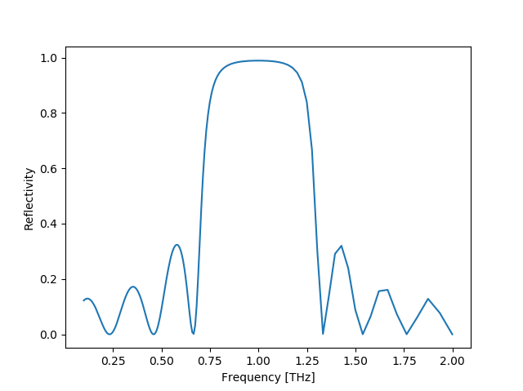
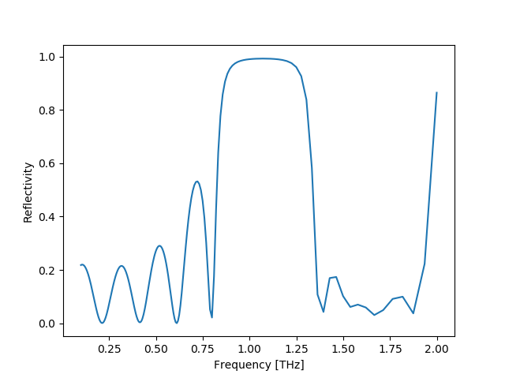
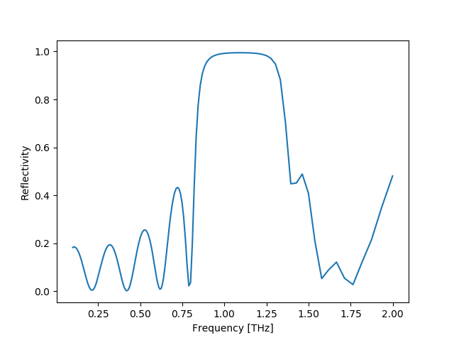
Figure: design result (structure, spectrum, power distribution)
1 THz DBR
Theory
ARL
ANN
99%
FWHM
 | Theory | ARL | ANN
FWHM (THz) | 0.598 | 0.541 | 0.573
99% (THz) | 0.275 | 0.287 | 0.339

Slide 16
Method – 1x2 splitter
Paragraphs 구성
Integrated photonic 1x2 power splitter
Not a arbitrary device, fixed size.
2D FDTD simulation for time-saving
SOI platform: 9 um radii, 20x20 air-hole on 500 um box
not aim to maximize the operation bandwidth, broadband transmission 275 ~ 325 um
Fundamental TM mode, 1:1 uniform
Refractive index is fixed to n_{Si} = 3.41.
Figure: Design base structure and condition
Generate labeled data for training phase
Commercially available software Lumerical FDTD solutions
2 Intel Xeon CPU with 2.5 GHz clock speed and 383 GB RAM about 3 days to complete collecting 30,000 simulation data
Figure: Data transmission distribution

Slide 17
Figure: Design base structure and condition
T₁
T₂
: Etched
: Not Etched
Input

Slide 18
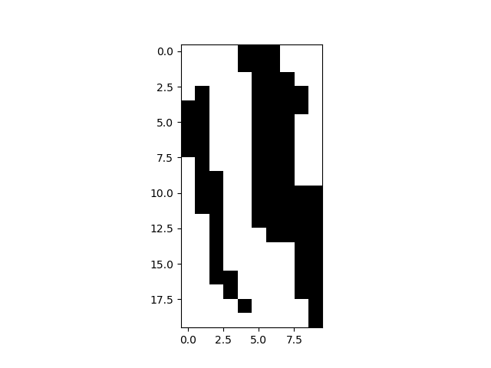
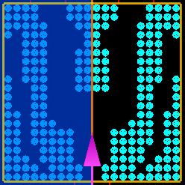
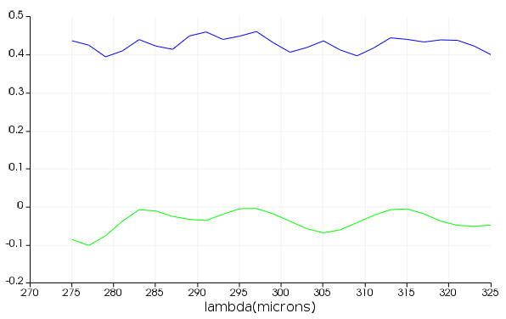
Figure: design result (structure, spectrum, power distribution)
# of data: 40,000
reward = min(T)
1x2 splitter TM
T
T
E
R
T ~0.43
Transmission
R ~0.05
Power uniformity = 0.71 dB

Slide 19
Figure: design result (structure, spectrum, power distribution)

Slide 20
Result & Discussion
Paragraphs 구성
“The two key criteria for a power splitter are low insertion loss, and excellent power uniformity.”[11]
The power uniformity = the ratio between the maximum and minimum
Figure: design result (structure, spectrum, power distribution)

Slide 21
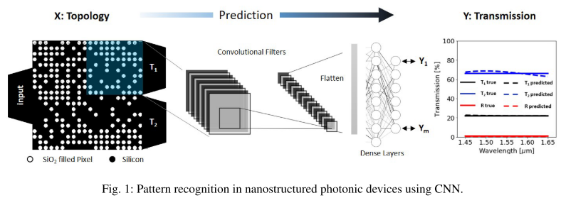
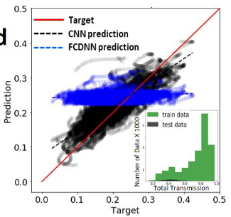
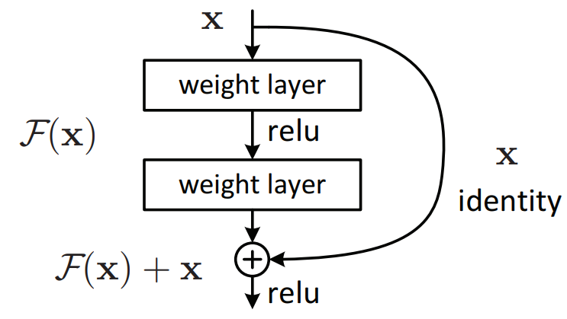
1 THz 1x2 Splitter Output Prediction
M. H. Tahersima, K. Kojima, T. Koike-Akino, D. Jha, B. Wang, C. Lin, and K. Parsons, “Nanostructured Photonic Power Splitter Design via Convolutional Neural Networks,” Conference on Lasers and Electro-Optics, 2019.
E
CNN

Slide 22
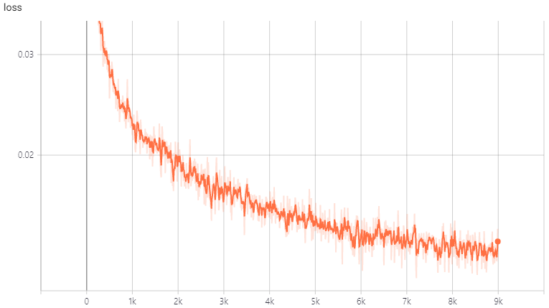
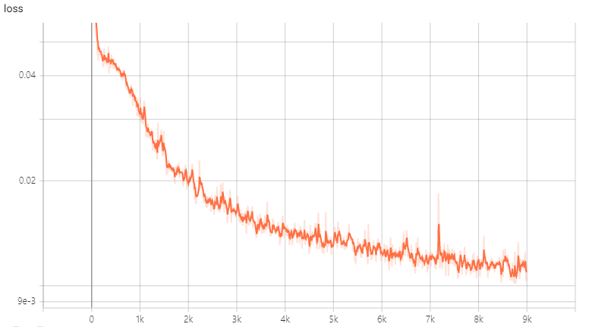


1 THz 1x2 Splitter Output Prediction
$$f\left(x\right)=g\left(x\right)+l(x)$$
FDTD
Neural
Network
loss
$$loss= \left|f\left(x\right)−g\left(x\right)\right|$$
FCNN
~ 0.015
ResNet
Learning Step
~ 0.010
Learning Step

